Slide 1
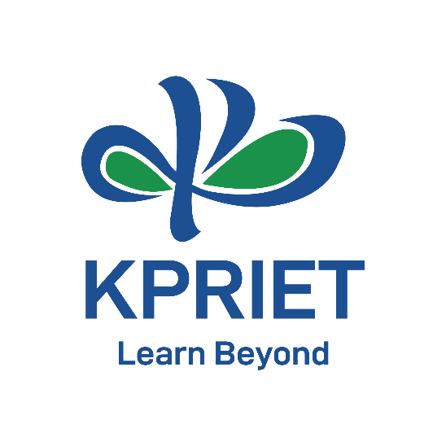
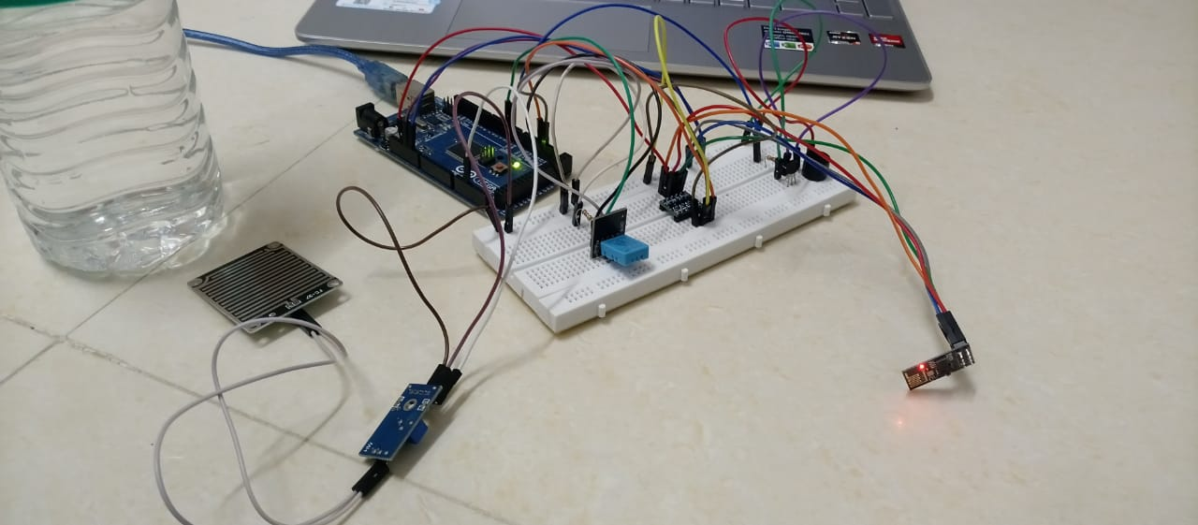
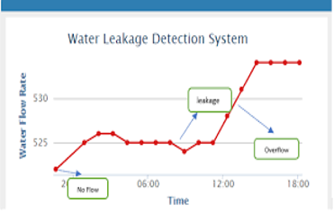
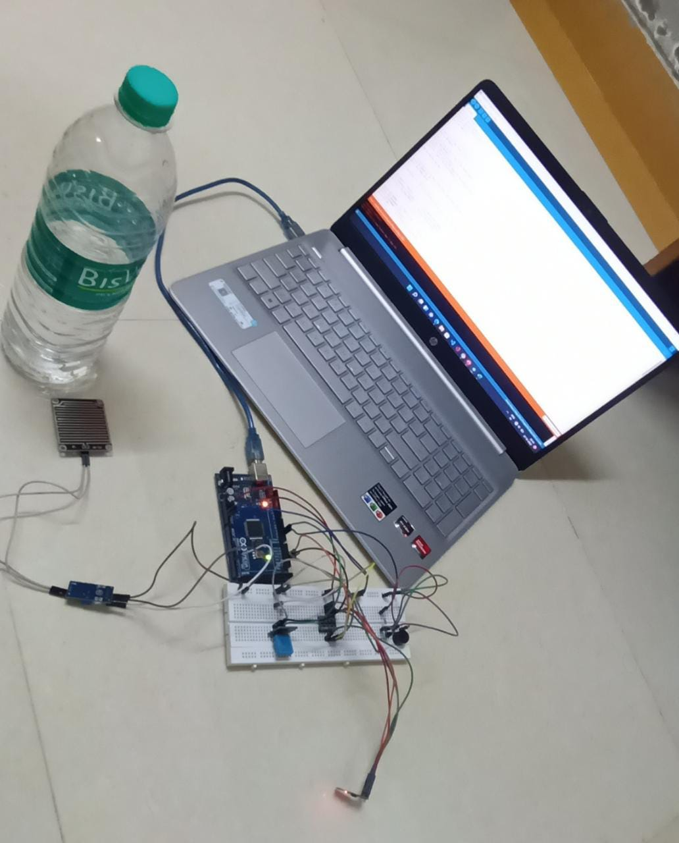
WATER LEAKAGE DETECTION SYSTEM
Mind blenders| Umarani M | CSE & ECE
Motivation/ Introduction
Results
This project is aims at developing Arduino based water leakage detection system that detects the water leakage in hospitals, buildings and industrial spaces where leakage could cause problems.
This poster presents the instrumentation of a Water Leak Detection System (WLDS), a simple but cost effective water detection system, implemented in residential areas and offers a detailed description of the system.
Using this system ,we can have a secure and continuous monitoring No need to go on field for monitoring so manual work has reduced it makes system more efficient, reliable, low cost and accurate we can monitor the data from anywhere and controlling is possible from a remote server.
SCOPE of the Project
No need to go on field for monitoring so manual work has reduced it makes system more efficient, reliable, low cost and accurate we can monitor the data from anywhere and controlling is possible from a remote server.
Methodology
There are several software development methodologies such as waterfall methodology, agile methodology, and so on. A software development methodology also can be defined as “the formalized process for handling large projects where documentation, training, integrity, and security are vital to the project's success”. SDLC projects naturally use object-oriented analysis and design. The selected software development methodology used was the Agile model. Agile methods and constant delivery are most well suited for dealing with the demands of the connected device. With Agile, the testing suits an important element of each stage of the development process at each stage. Agile methodology is chosen because at every stage of this project testing becomes an important element of each stage of the development process since it involves the devices that were connected with the microcontroller and to produce output according to the system of that project (Water Leakage Detection System). Also, it helps when there is a change in the requirements, technology, or tools that are used in the project so due to that it makes it easy to adjust your approach to target high-priority issues. The agile model mostly is used in the development of the IoT project. While there is an advantage of using the Waterfall model, but Agile is a very crucial important software development method in the IoT project.
Conclusion/ Summary
The system can monitor water leakage automatically, and it is low in cost and does not require people on duty. This system is used to avoid the huge amount of water is being wasted by uncontrolled use of home/offices etc. The water leakage detection is likely to be more economical, convenient and fast. As each and every variation of water level is informed to the cloud through the internet and nearby people can be informed in time. Thus saving lots of lives avoiding unpleasant scenarios.
Acknowledgments/ References
1. https://www.arduino.cc/en/Guide/ArduinoMega2560
2. http://playground.arduino.cc
3. https://learn.adafruit.com/category/learn-arduino
4. Sams Teach Yourself “ Arduino Programming” by Richard Blum, Pearson Education 2015.
5. https://www.ej-compute.org/index.php/compute/article/download/43/15
Contact Details
21cs071@kpriet.ac.in
21ec061@kpriet.ac.in

